Slide 1


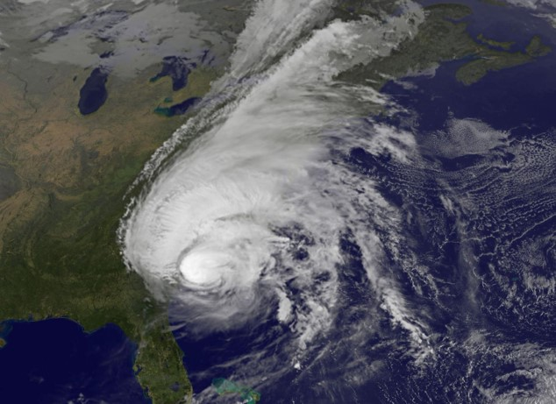
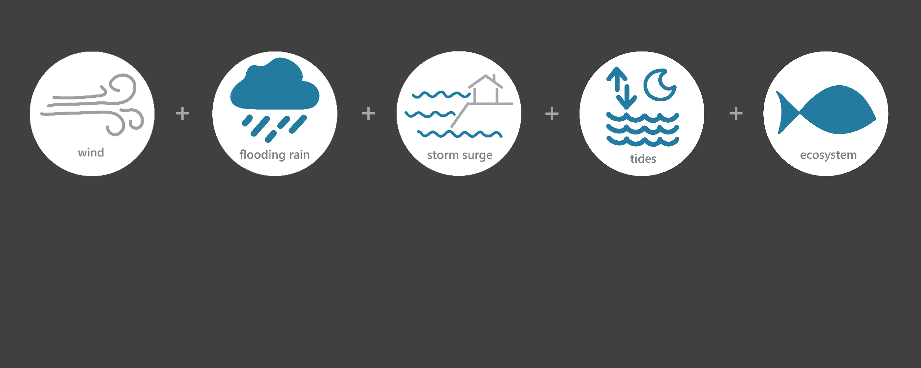

[ OCT 5 – OCT 10, 2016 ]
HURRICANE MATTHEW
ES
Category (extratropical storm)
2.4
Inches of Rain
28.6
Miles per hour of Max Wind Speed
2.3
Feet of Storm Surge (max)*
Image Credit: NASA-NOAA_GOES, taken on October 10, 2016
Monitoring the Impact of Hurricane Matthew at “Delaware NERR”
Matthew lost its tropical characteristics early on Oct. 9th as it moved eastward and then northeastward away from the United States. However, the large circulation of the extratropical low pressure system still managed to produce some flooding rains across the Delmarva Peninsula, along with minor beach erosion from Delaware to Long Island. Lower Delaware experienced heavy rainfall, some winds, and flooding. The effects of Matthew were observed at the Delaware NERR (DNERR) Research Reserve through the System-Wide Monitoring Program (SWMP), which tracks short-term variability and long-term change of weather and water quality in the areas surrounding Dover and Kent County, Delaware.
Data shown are based on the DNERR weather monitoring site
*Data based on the NOS Lewes gauge
Created on May 31, 2022

Slide 2

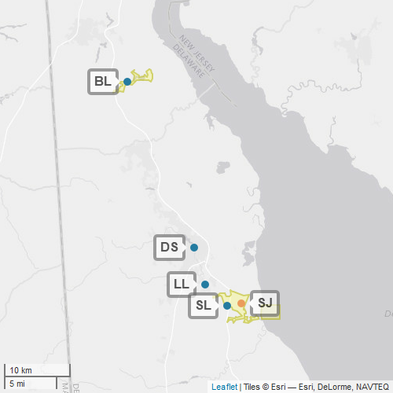
DNERR
Delaware NERR (DNERR) is one of 30 sites in the National Estuarine Research Reserve Systems (NERRS). Each site is a state-federal partnership that combines research, monitoring, and education to advance the understanding and management of estuarine environments.
DNERR
NERRS
Centralized Data
Management Office
DNERR Storm Monitoring
Weather Station
DNERR operates a weather station located in Saint Jones River (SJ) and maintains four continuous, long-term water quality stations at Blackbird Landing (BL), Division Street (DS), Lebanon Landing (LL), and Scotton Landing (SL) locations. DNERR is part of the SWMP. As Hurricane Sandy approached Delaware, DNERR monitored the weather and water quality, collecting data every 15 minutes for the following parameters: air temperature, relative humidity, atmospheric pressure, rainfall, wind speed and direction, water temperature, depth, salinity, dissolved oxygen, turbidity, and pH.
Water Quality Sample Location

Slide 3
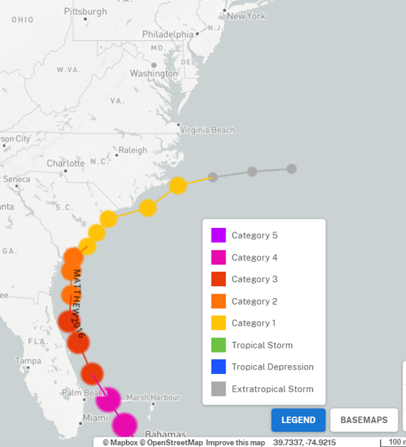
Matthew traveled along the Florida coast as a category 3 hurricane. Matthew weakened to a category 2 near the Georgia coast and then transitioned to a category 1 near South Carolina. On Oct. 9th, Matthew traveled along the southeastern coast of North Carolina before becoming an extratropical storm as it turned northward.
Delaware experienced heavy rains, some winds, and storm surge that resulted in flooding across the Delmarva Peninsula, along with minor beach erosion from Delaware to Long Island. No injuries were reported in the state of Delaware.
Source: https://oceanservice.noaa.gov/news/historical-hurricanes/
DNERR
Matthew was an extratropical storm as it moved northward and passed south of the reserve and eastward back out in the Atlantic Ocean.
Damage and losses due to Matthew’s impacts on the United States totaled $11.7 billion (adjusted for 2022). In the United States, the most sigificant damage occurred in Florida, Georgina, South Carolina, and North Carolina.
Aquatic life (i.e., oysters, crabs, lobster, fish, aquatic plants, phytoplankton) rely on specific levels of salinity, dissolved oxygen, and turbidity to thrive and survive. The water quality in the reserve was impacted by Matthew with a temporary drop in salinity levels and spike in turbidity levels which could potentially stress organisms.
Station | Date | Total Precipitation (in) | Average Rel. Humidity (%) | Max Wind Speed (mph) | Average Wind Speed (mph)
Saint Jones River | 10/6/2016 | 0.00 | 79.8 | 13.9 | 8.4
Saint Jones River | 10/7/2016 | 0.00 | 89.1 | 13.4 | 7.2
Saint Jones River | 10/8/2016 | 0.50 | 97.5 | 10.5 | 6.0
Saint Jones River | 10/9/2016 | 1.93 | 86.7 | 28.6 | 18.0
Saint Jones River | 10/10/2016 | 0.00 | 57.5 | 22.1 | 11.3
The highest local rainfall and wind measurements were recorded when Matthew turned northward and moved to the south of Delaware.
Data reporting time periods for Hurricane Matthew: 10/6/2016 - 11/10/2016

Slide 4
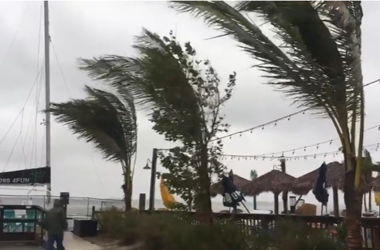
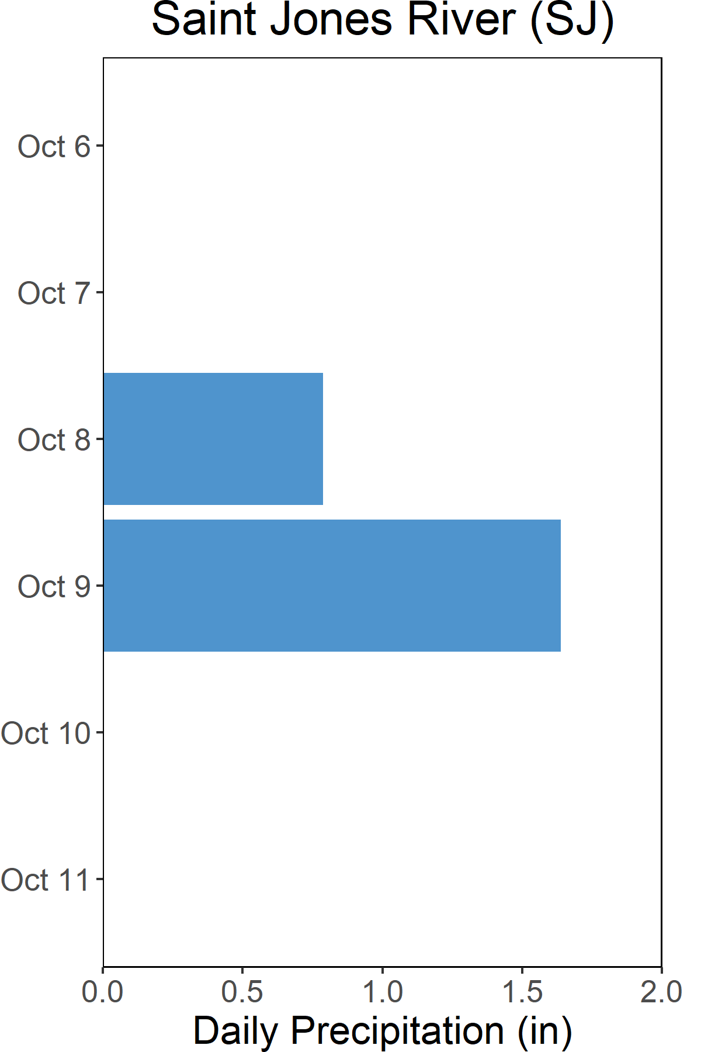

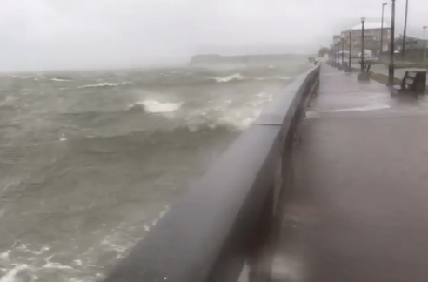
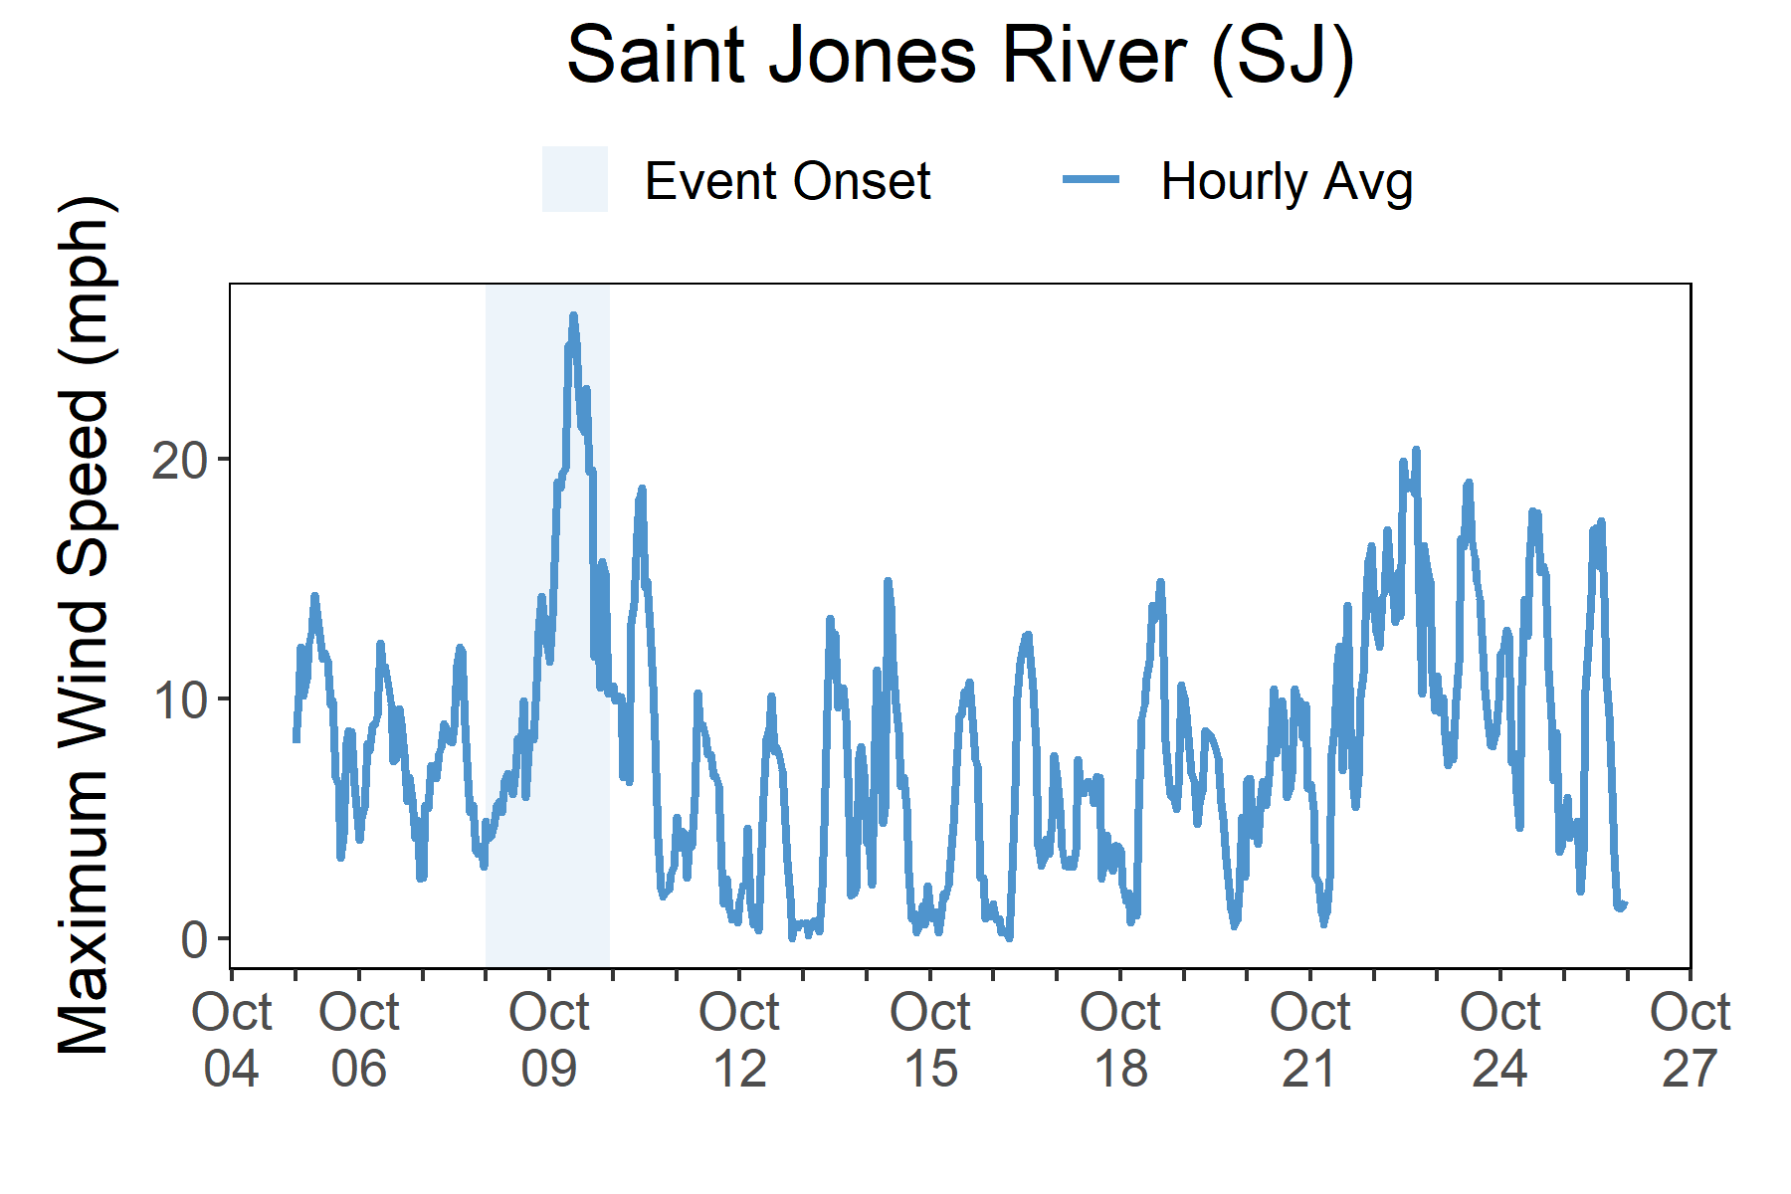

Rainfall
Matthew brought rains and freshwater and storm surge flooding to areas of the Delmarva Peninsula.
A total of 2.4 inches of rainfall fell in the reserve area over the course of two days.
The large circulation of the extratropical low pressure system of Hurricane managed to produce some flooding rains across the Delmarva Peninsula, along with minor beach erosion from Delaware to Long Island. Rains fell over Delaware with 2.4 total inches of rainfall recorded at the St. Jones River weather station.
Storm surge of 2.3 ft was recorded at the Lewes (8557380) National Ocean Service (NOS) gauge. The maximum wind speed recorded at the St. Jones River weather station was 28.6 mph.
As Hurricane Matthew traveled along the southeastern region of the United States from Oct. 7 through Oct. 9, it hit closely to the coasts of Florida, South Carolina, Georgia, and North Carolina, causing these states the most significant damage.
Areas of these states experienced structural damage to homes and businesses, and widespread downing of trees, utility lines, and poles, which caused massive power outages as a result of rainfall, winds, and storm surge impacts.
Rainfall measurements at the St. Jones River weather station from Oct. 6 through Oct. 11.
Wind Speed
Max wind speed recorded at the reserve was 28.6 mph on Oct. 9.
Maximum Wind Speed readings at the St. Jones River weather station from Oct. 6 through Oct. 11.

Slide 5
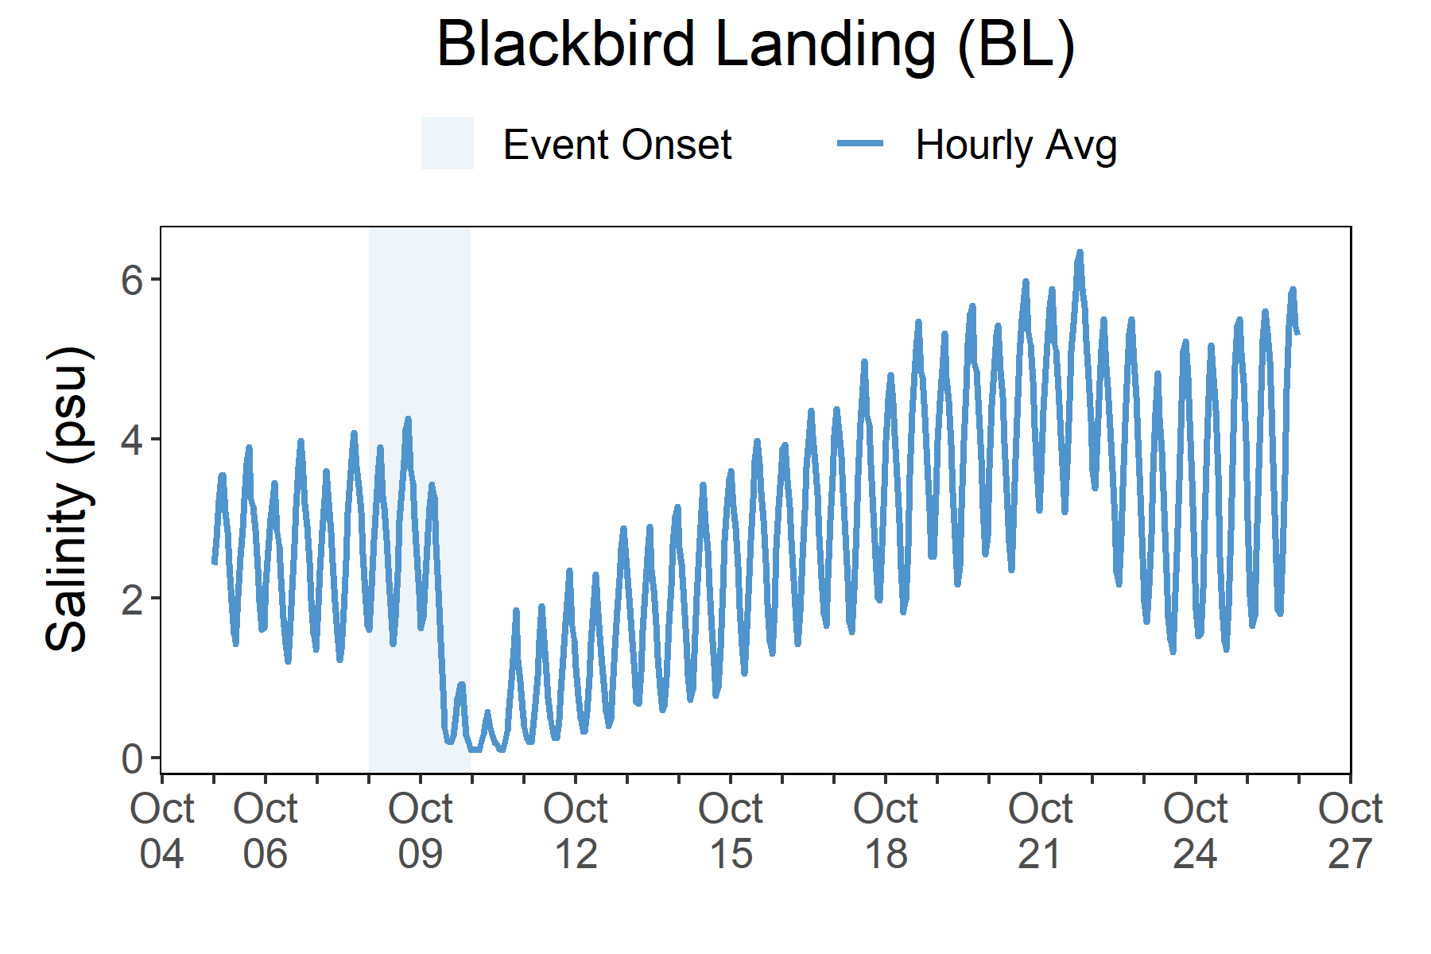
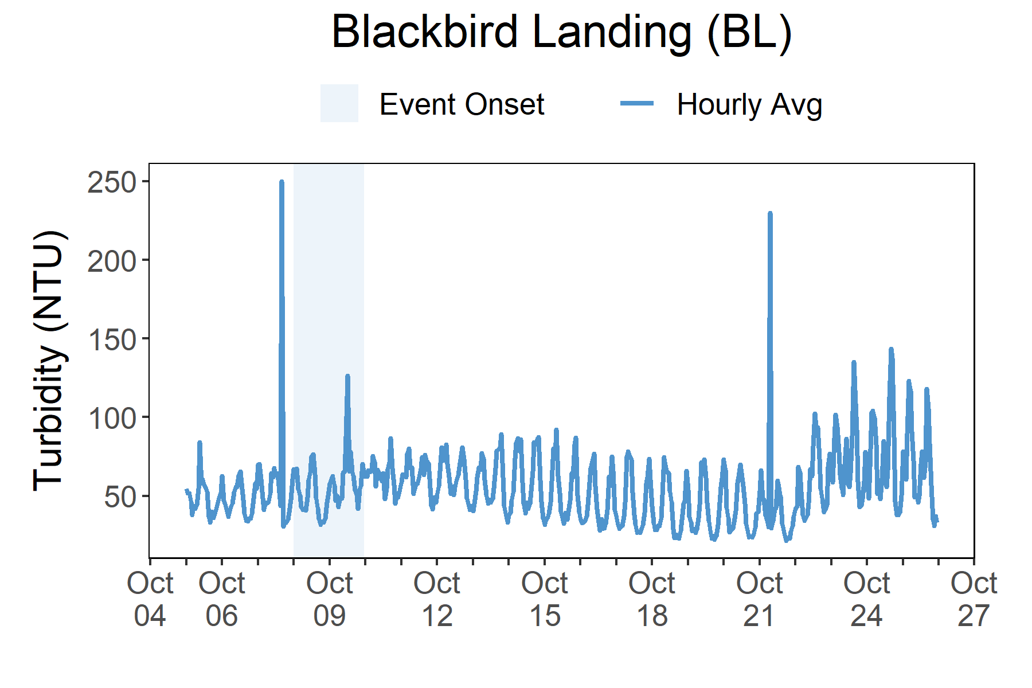

Salinity levels quickly dropped at Scotton Landing (SL) as Sandy approached the reserve and then rebounded a few days later.
Station | Date | Turbidity Maximum (NTU) | Salinity Minimum (psu) | Salinity Maximum (psu) | Dissolved Oxygen Minimum (mg/L) | Dissolved Oxygen Maximum (mg/L)
Blackbird Landing | 10/6/2016 | 83 | 1.2 | 4.2 | 4.2 | 6.9
Blackbird Landing | 10/7/2016 | 889 | 1.2 | 4.2 | 3.1 | 6.9
Blackbird Landing | 10/8/2016 | 89 | 1.4 | 4.4 | 3.7 | 6.8
Blackbird Landing | 10/9/2016 | 159 | 0.2 | 3.8 | 3.9 | 7.5
Blackbird Landing | 10/10/2016 | 91 | 0.1 | 1.2 | 4.5 | 7.8
Data reporting time periods for Hurricane Sandy: 10/6/2016 - 10/11/2016
Salinity
Turbidity
Salinity decreased with the onset of Matthew.
Only a slight increase in turbidity was observed during the storm.
Salinity levels from Oct. 5 to Oct. 26.
Turbidity levels from Oct. 5 to Oct. 26.
Salinity and Turbidity levels that were recorded at the Blackbird Landing (BL) station show initial and post-storm impacts on water quality in this area. Salinity levels quickly dropped at the onset of the storm and then recovered a few days later. Turbidity levels (i.e., particles suspended or dissolved in water like sediment such as clay, silt, etc.) show a sharp increase before the storm onset (not likely related to the storm) and a slight increase during the storm. Dramatic changes in water quality such as salinity and turbidity can cause stress to some aquatic organisms depending on the species and how long the levels deviate from what is normal. Water quality stresses can impact survival and future populations.
Every plant and animal species have habitat preferences and requirements. Understanding these habitats is critical to understanding populations.

Slide 6


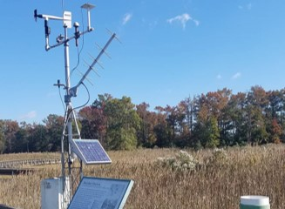
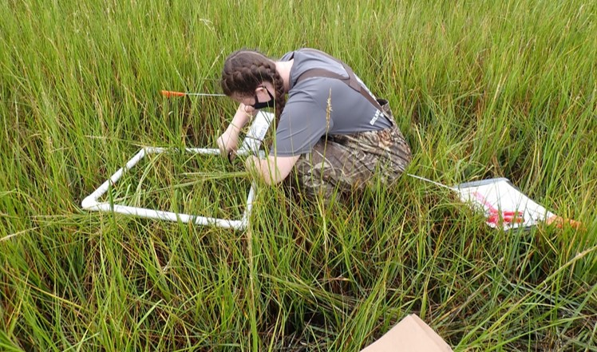
Kari St. Laurent, Phd, Research Coordinator (DNREC) e: Kari.StLaurent@delaware.gov p: 302-735-3413
Visit www.nerrsdata.org to view and download weather and water quality data from Delaware NERR.
Interested in learning more? Visit https://dnrec.alpha.delaware.gov/coastal-programs/research-reserve/.For video, news updates, online storm data and prediction visualization tools, check out our Storm Story Map at www.storm storymap.url.
@DNERR

